Slide 1
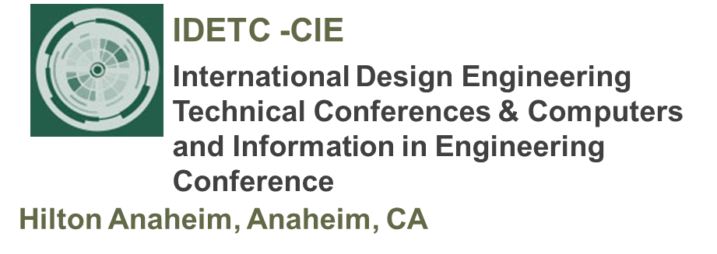
Tutorial 1 Learning Topology Optimization Through Examples and Case Studies
August 18, 2019

Slide 2
Performance Objectives & Constraints

Slide 3
Compliance Minimization
Classic
Popular
Leads to stiff designs

Slide 4
Alternate Objectives and Constraints
Objectives
Leads to stiff designs

Slide 5
Questions?

